Slide 1
BmAi
Artificial Intelligence against Malnutrition
Notes:
Okay, so hello everyone, My name is ahmed ben haj yahia and Today i’m presenting my contribution to the BmAI project which tackles the problem of malnutrition in developping countries

Slide 2
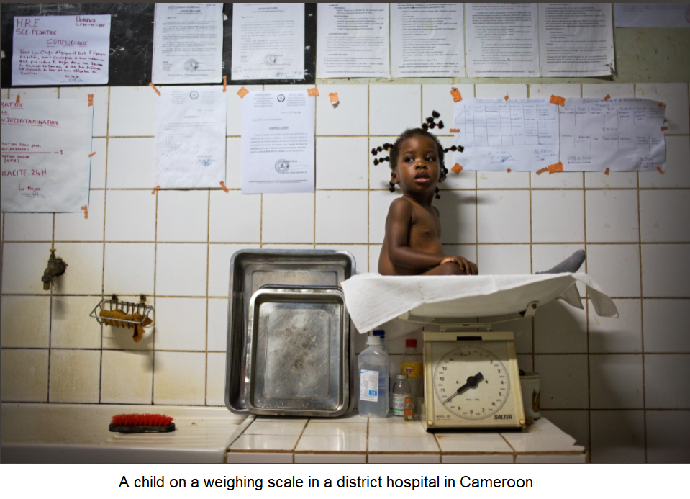
Context
Malnutrition is still widespread in the world.
Body measurements are an essential tool to assess the nutritional status of people
These measurements are often imprecise and unreliable especially with children
In many developing countries of today’s world, scales and measuring boards are becoming scarcer than mobile phones.
Notes:
So to put you in Context,
Malnutrition is still widespread in the world,
And Body measurements are an essential tool to assess the nutritional status of people.
However, these measurements are often difficult to realize in practice
especially with children, and are often imprecise and unreliable.
Additionally, in many developing countries, scales and measuring boards are becoming scarcer than mobile phones.

Slide 3
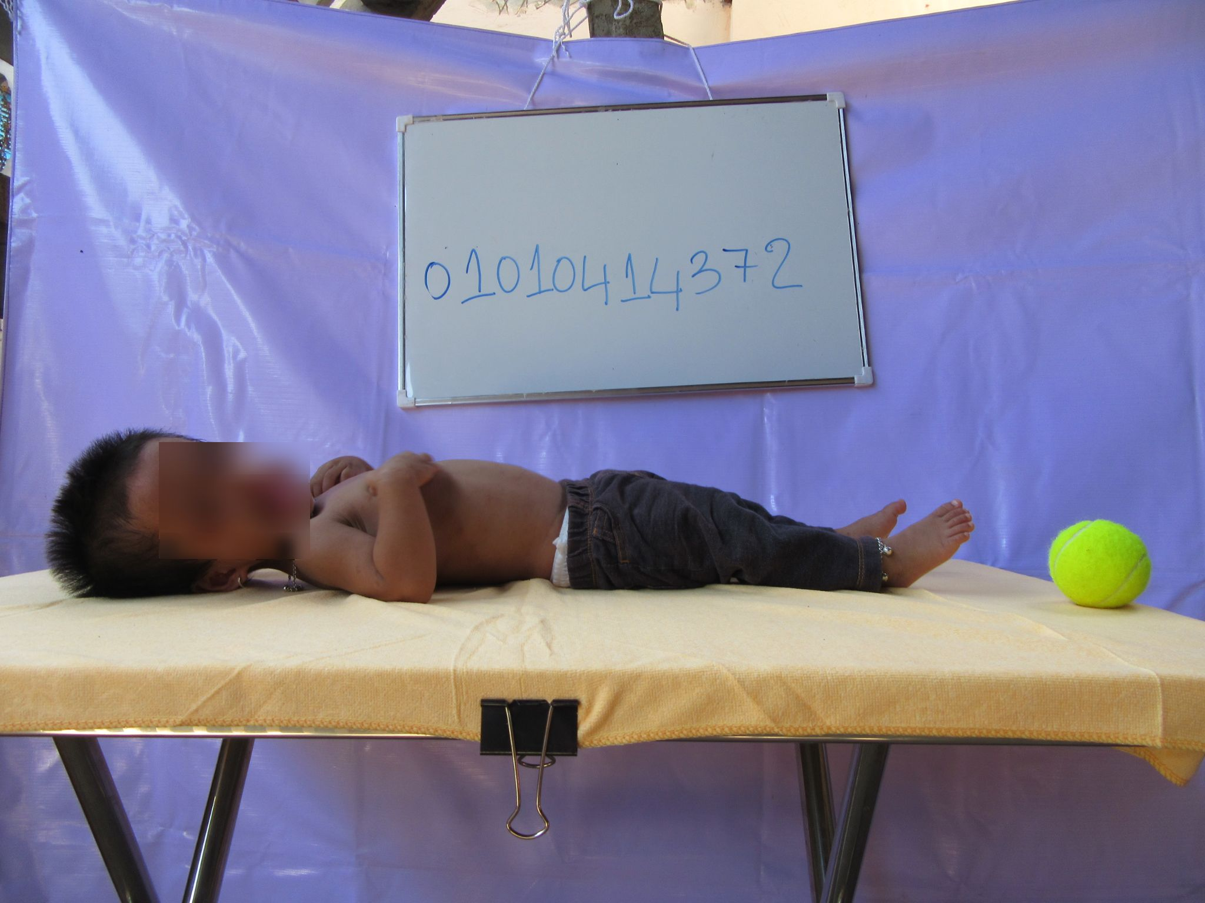
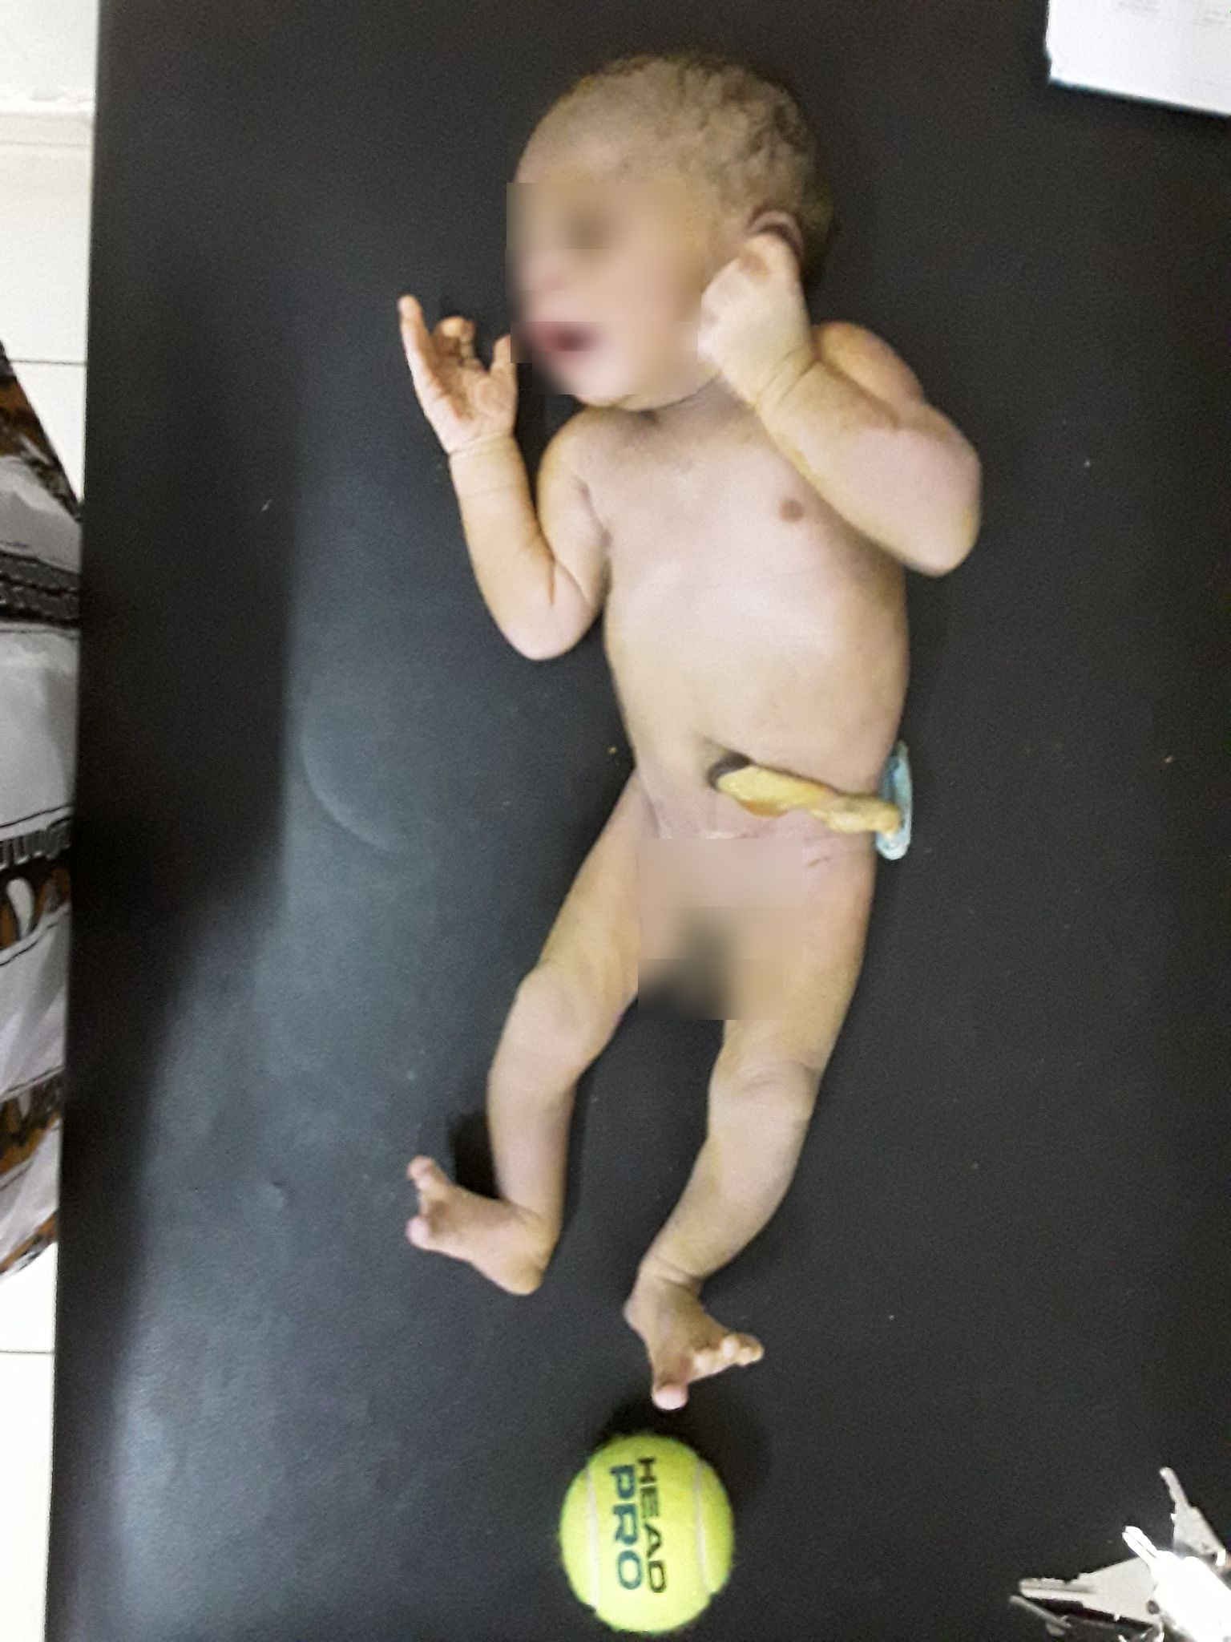
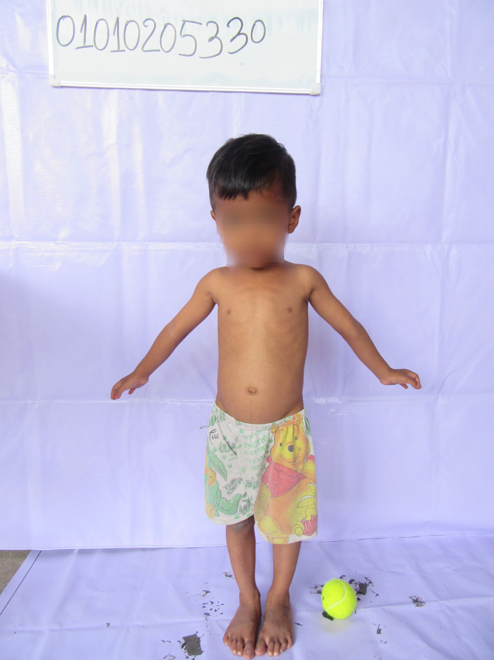
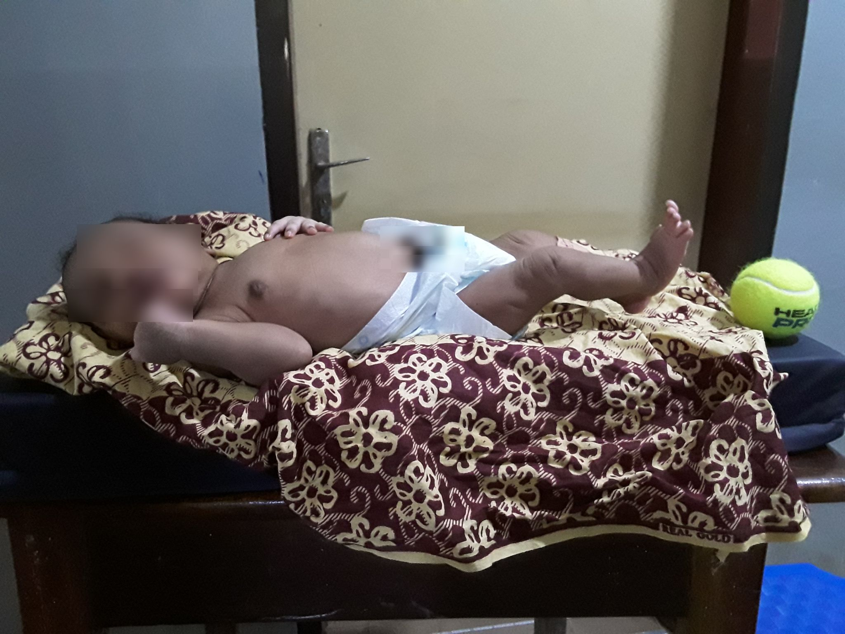
Goal
Develop a Deep Learning solution that can estimate body measures from mobile phone pictures.
Not an easy task since Images are obtained in an unconstrained setting:
Location and orientation of the camera.
Background.
Lighting conditions.
Pose of the child.
Clothes worn by the child.
Image resolutions
Notes:
So the goal is
To develop a deep learning solution that can estimate body measures from mobile phone pictures
And its not an easy task, since images are obtained in an unconstrained setting : with
Location and orientation of the camera,
Background
Lightning conditions
Pose of the child (newborns can’t stand)
Clothes worn by child

Slide 4
Objectives
Long term objectives:
Develop mobile applications that can estimate body measures from mobile phone pictures in a rapid, easy, automatic, reproducible, and accurate manner.¹
Short term objectives:
Obtain a model achieving a relative error smaller than 5% on the height and weight predictions.
The priority is given to newborns from Guinea.
bmAi. (n.d.). Essentialtech. Retrieved February 4, 2022, from https://essentialtech.center/project/bmai/
Notes:
So,
The long term objective is to develop a mobile application that can estimate body measures from mobile phone pictures.
And the short term goal is to achieve a relative error on height and weight predictions, smaller than 5% . With the priority given to newborns from Guinea

Slide 5
Challenges
The model must learn image representations:
Invariant to the aforementioned variations.
Retaining the predictive attributes.
Light enough to be deployed on phones. (Mobilenet ?)
The initial idea was to use a model trained for a similar task and with a large dataset.
➔ The similar task is Pose estimation.
Notes:
To solve the task,
the model must learn image representations that are
Invariant to the aforementioned variations and
Retaining the predictive attributes.
It should also be light enough to be deployed on phones so the use of Mobilenet seems to a suitable alternative.
The initial idea was to use a model that is already trained for a similar task and with a large dataset.
⇒ This similar task is pose estimation.

Slide 6
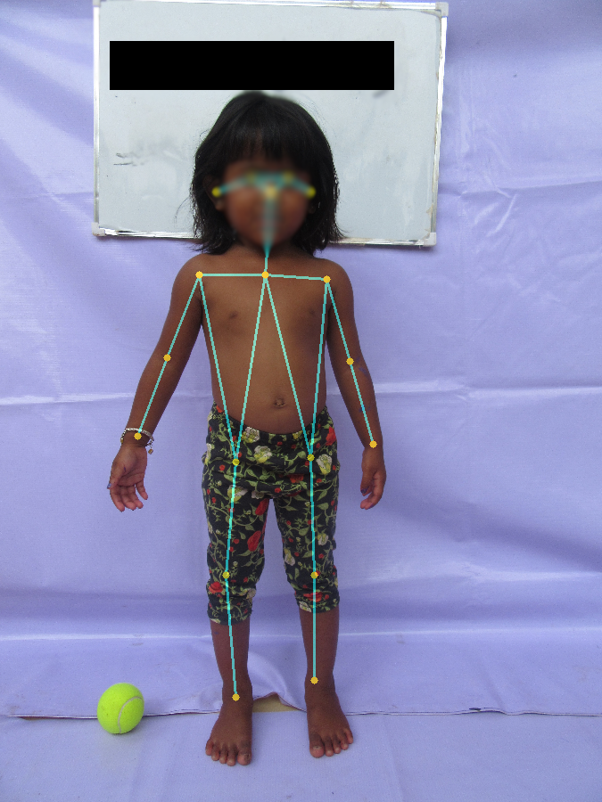
OpenPose (1)
OpenPose is the first open-source real-time system for multi-person 2D pose detection ¹, including body, foot, hand, and facial key points.
OpenPose: Realtime Multi-Person 2D Pose Estimation using Part Affinity Fields. https://arxiv.org/pdf/1812.08008.pdf
Notes:
So we will use Transfer learning from OpenPose
which is the first open source real-time system for multi person 2D pose detection.

Slide 7
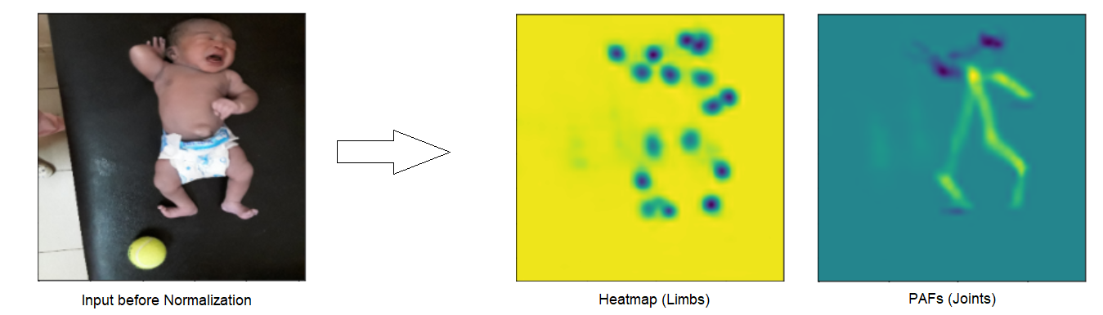
OpenPose (2)
PAFs
PAFs
Refinement Stages (5)
Input IMG
VGG-19
CPMs
Initial Stage
F
Heatmaps
Heatmaps
Notes:
OpenPose uses
VGG-19 to generate
Feature Maps F that are input to
Convolutional Pose Machines,
which output is then fed to the Initial stage. At this stage, the network produces a set of
part affinity fields (PAFs) which represents the Joints
and confidence maps or heatmaps that represent the limbs.
The subsequent stages are referred to as Refinement Stages and in each subsequent stage, the predictions from the previous stage and
the original image features F are concatenated and used to produce refined predictions.
The output is shown in the image below
What does the initial stage do ?
Basically, in the initial stage, there is a block of convolutions that is applied to the input, and the result of that block is then fed to two different blocks of convolutions, one will lead to the PAFs and the other to the Heatmaps. In baseline 4 we stopped at the output of the first block, so before separating PAFs and Heatmaps.
Part Confidence maps are the location of the joints
PAFs are the degree of association between parts (using vectors)
How to find pose:
1) find all joints location (using confidence map)
2) find which joints go together using PAFs
3) associate limbs to persons to get final list of human poses
Potential questions : What does CPMs do ?
It consists consist of a set of convolutional networks that repeatedly produce heatmaps for the location of each part of the body. And at each stage, image features and the heatmaps produced by the previous stage are used as input to produce refined heatmaps.

Slide 8
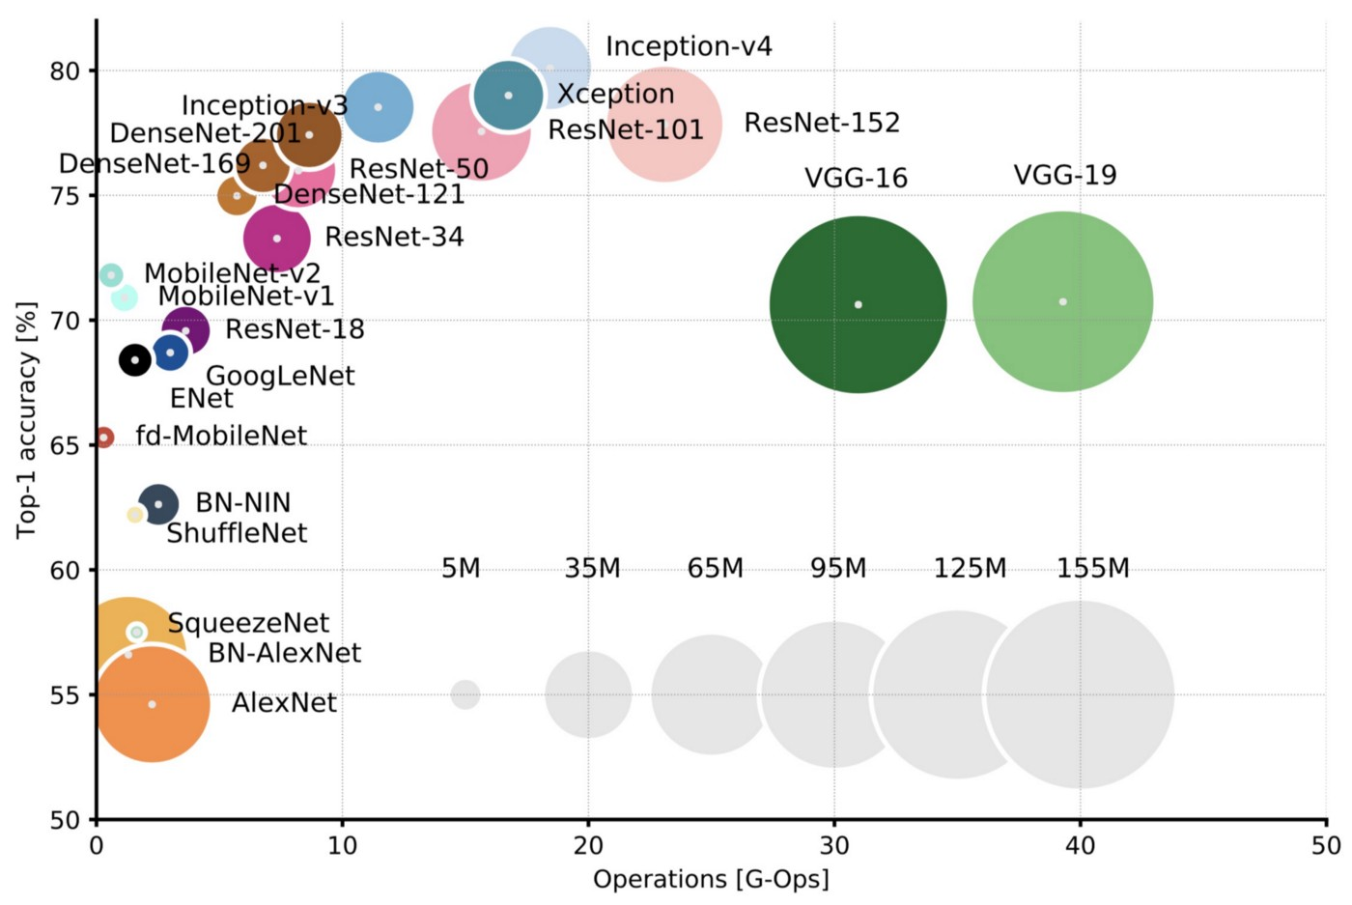
OpenPose (3)
VGG-19 :
huge # of network parameters
computationally heavy
➔ Idea:
use a Lightweight version of OpenPose ¹ which uses Mobilenet_v1 instead of VGG-19, with only one Refinement Stage
Top-1 one-crop accuracy versus amount of operations required for a single forward pass. The size of the blobs is proportional to the number of network parameters ²
Real-time 2D Multi-Person Pose Estimation on CPU: Lightweight OpenPose https://arxiv.org/pdf/1811.12004.pdf
An Analysis of Deep Neural Network Models for Practical Applications https://arxiv.org/pdf/1605.07678.pdf
Notes:
As you can see in
the comparative figure of deep neural network models,
VGG-19 has
a huge amount of parameters and is computationally heavy
So the idea is
to use, a Lightweight version of OpenPose ¹
which uses Mobilenet_v1 instead of VGG-199 and uses only one refinement stage instead of five

Slide 9
Previous work
Custom Loss:
Only penalizes predictions of height and weight that vary more than 5% from the true values.
This custom loss function will be used throughout the project
Notes:
So, as previous work done on the project,
a custom loss function was defined, in alliance with the goal of the project , that is,
to only penalize predictions that vary more than 5% from the true values.
And This custom loss will be used throughout the project.

Slide 10
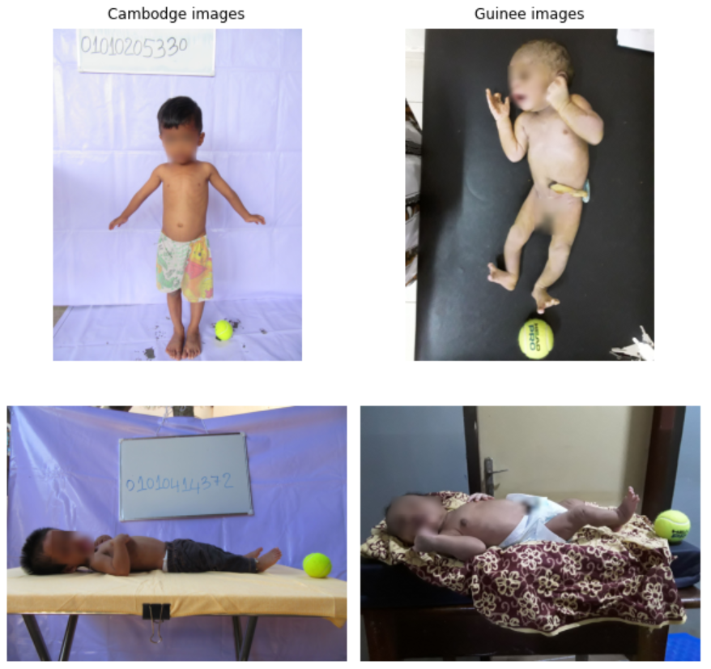
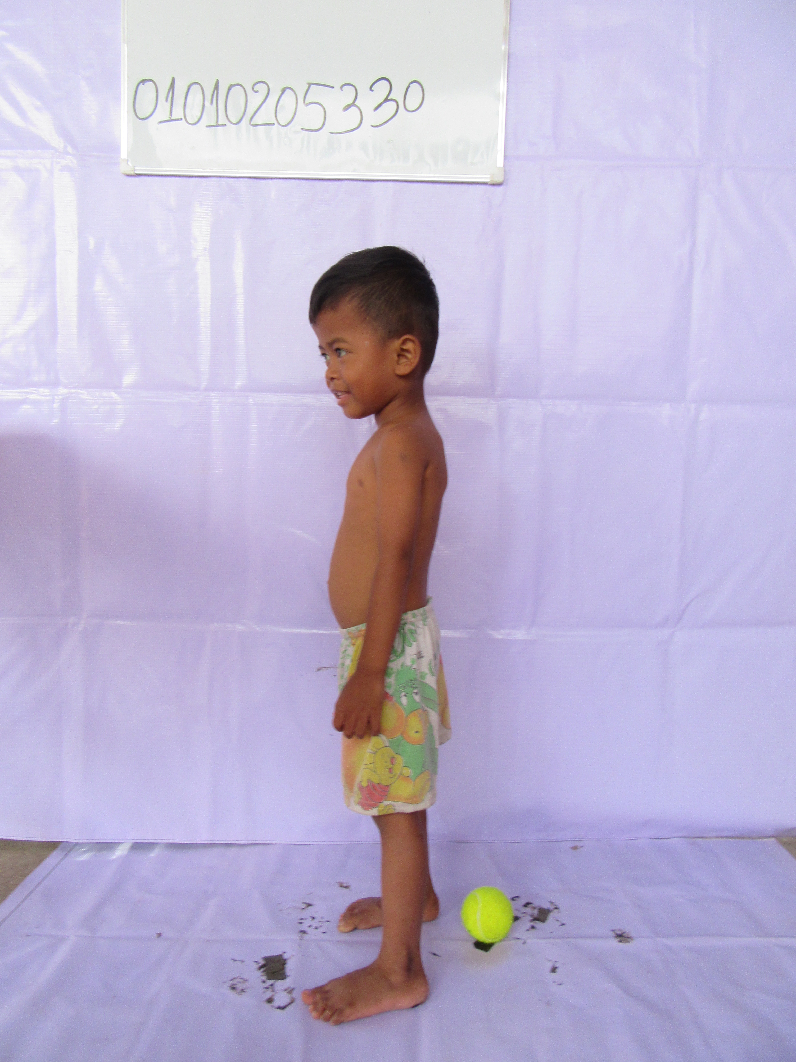
Data (1)
Two different datasets of children images from two different countries:
New Guinea :
766 images
new-born lying children
Front side.
Cambodia :
6941 images
A wide range of ages.
Front and side images for standing kids.
Notes:
Now lets present the data, which consists of
two different datasets of children images, collected from two different counties.
Images from New Guinea are of new born children. in a lying position and mainly capture the front side.
Children Images from Cambodia have a wide range of ages. So we can find babies in a lying position, but there is mainly images of standing children. and For almost each standing child, this dataset captures front and side images
Notice the big difference in size between the two datasets

Slide 11
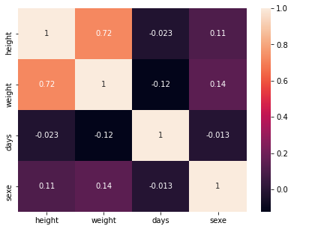
Data (2)
Guinea:
Data is Balanced in SEX attribute.
Height and Weight are correlated
Very weak correlation between (Sex, Age) and (height, weight)
Notes:
Now,
for Guinee images,
the data is balanced in SEX,
And we can see the correlation map between the attributes.
As we could imagine, we can see that Height and Weight are highly correlated.
but We can also see that SEX and Age are almost uncorrelated with both height and weight

Slide 12
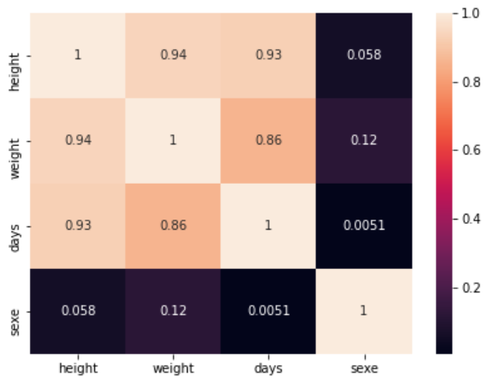
Data (3)
2. Cambodia
Data is Balanced in SEX attribute.
Height and Weight are highly correlated
Age is highly correlated with both Height and Weight
Sex is almost uncorrelated with Height and Weight
Notes:
Now,
For Cambodia
The data is also balanced in SEX
For correlations we can see that
Height and weight are highly correlated (more than what we saw before for guinea)
Now for age, we see that it is highly correlated with both height and weight and that’s because the data have a wide range of ages. (from 6days to almost 7years)
Whereas sex is almost uncorrelated with height and weight.

Slide 13
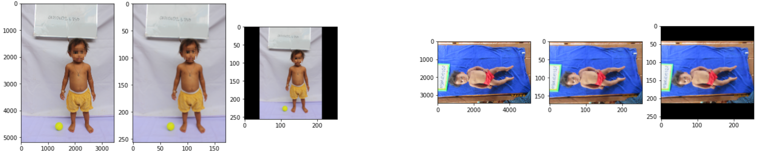
Data preprocessing
Images in different dimensions
OpenPose trained on 256x256 images
➔ Resize all images to (256x256)
Resize
Pad
Pad
Resize
Results in fixed size images (256x256) with unchanged aspect ratio.
Notes:
For both datasets,
images are in different sizes.
And Open pose was trained on 256x256 images, so
we resize all our images to that dimension
by using padding on the resized images,
we keep the aspect ratio unchanged

Slide 14
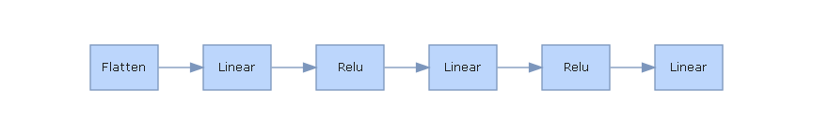
Pretrained lightweight OpenPose model (1)
Lightweight OpenPose
model
Joints
IMG
Pooling
Limbs
Regression model
Notes:
The first approach,
consists of using the whole pretrained lightweight network of OpenPose as feature extractor.
The resulting Part Affinity fields which are the connected joints, are then
fed to our simple regression model consisting of a Pooling layer and some fully connected layers with the output being the predicted Height and weight.

Slide 15
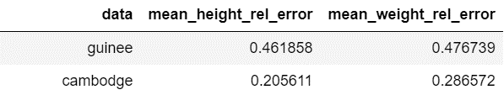
Pretrained lightweight OpenPose model (2)
20% Difference
Far from 5% threshold (Bad results)
PAFs (joints) are not sufficient
Model may be way too complex for Guinee images
→ Loss of information
Notes:
As expected,
You can see that the model did not perform well and
we are far from our 5% goal.
The regression only uses Part Affinity Fields which are the connected joints to make its prediction, and this is not enough
because we lose a lot of information from the initial image
The big difference in performance between Guinea and Cambodia
may be explained by the fact that Guinee data consists of only 7 hundred images and this is not enough for a model of this complexity.
(here we did not use any data transformation)

Slide 16
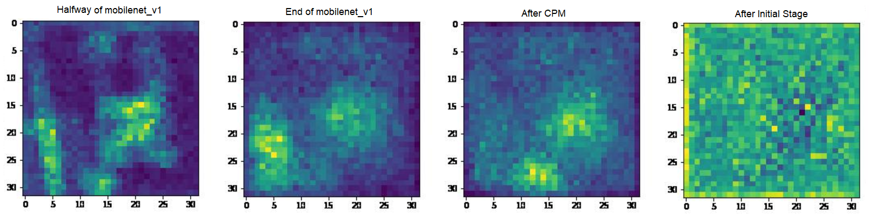
Pretrained lightweight OpenPose model (3)
Feature map visualization
Manually created 4 models with same regression part but with different inference models
Halfway through Initial Stage
Baseline_1 : Inference model stops halfway through Mobilenet_v1.
Baseline_2 : Inference model stops at the end of Mobilenet_v1.
Baseline_3 : Inference model stops after CPM.
Baseline_4 : Inference model stops after halfway through Initial Stage.
Notes:
So as a next step,
we visualized the feature maps of each phase in the OpenPose lightweight network
and we created 4 models with same regression part but with different inference models,
So In Baseline_1 the Inference model stops halfway through Mobilenet_v1.
In Baseline_2 : Inference model is basically Mobilenet_v1 .
In Baseline_3 : Inference model stops after Convolutional Pose Machines.
And in Baseline_4 : Inference model stops halfway through Initial Stage, so just before generating PAFs and heatmaps
What does the initial stage do ?
(Basically, in the initial stage, there is a block of convolutions that is applied to the input, and the result of that block is then fed to two different blocks of convolutions, one will lead to the PAFs and the other to the Heatmaps. In baseline 4 we stopped at the output of the first block, so before separating PAFs and Heatmaps.)
Why do this (feature maps) ?
The Whole OpenPose lightweight model is way too complex for the data we have. So, We choose to visualize feature maps and manually select when to stop the inference model. This will help us identify which part of OpenPose model can help us in our task.
So here we chose 4 different places to stop at, halfway through Mobilenet_v1, then at end of Mobilenet_v1, then after CPM and finally just before producing joints and limbs. (before the separation) by training those 4 models we can know where to stop the inference model.
What does CPM do ?
It consists consist of a set of convolutional networks that repeatedly produce heatmaps for the location of each part of the body. And at each stage, image features and the heatmaps produced by the previous stage are used as input to produce refined heatmaps.

Slide 17
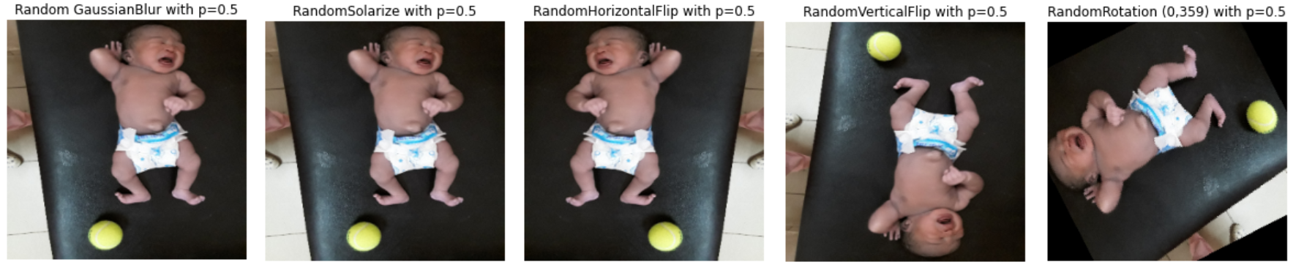
Data Augmentation
Transformations applied randomly with probability 0.5:
Gaussian Blur
Solarize
Horizontal flip
Vertical flip
Rotation (0,359)
Notes:
And Before running our models, we did Data Augmentation by applying to our images
a list of transformations, like blurring, flips and rotations
The resulting images are shown here , and Each of these transformations is applied randomly with probability 1/2 one half .

Slide 18
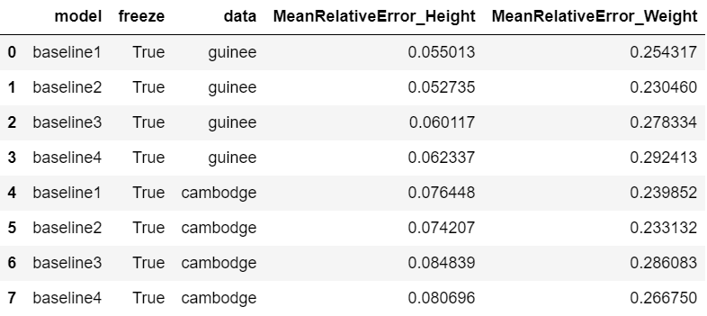
Results
Mobilenet_v1
Guinee :
5.2% for Height
Cambodia :
7.4% for Height
23% for Weight
23.3% for Weight
Notes:
By training those 4 baseline models on our two datasets,
We find these results And we can see from the table, that overall,
Baseline 2 which is basically Mobilenet_v1, is the most performant model,
with mean relative error for height of 5.2% on Guinee
and 7.4% on Cambodia.
The mean relative error for weight Is 23% for both datasets and is still high but improved significantly compared to what we had before.
Training is done for 30 epochs, with batch size of 128, using Adam optimizer and a learning rate of 0.05, with a train_test split of (80%,20%) for 4 different seeds

Slide 19
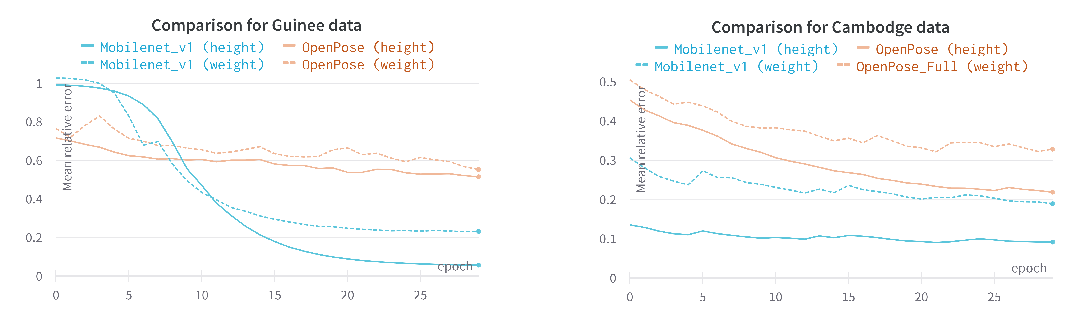
Mobilenet_v1 vs Full lightweight OpenPose
Inference model |  | Lightweight OpenPose |  | Mobilenet_v1
Guinea Dataset | Attribute | Height | Weight | Height | Weight
 | Mean Relative error
Cambodia Dataset | Attribute | Height | Weight | Height | Weight
 | Mean Relative Error
46%
47%
5.2%
23%
20%
28%
7.4%
23%
Notes:
As we can see here. Compared to the results we had using the whole OpenPose model, the performances have improved a lot using only mobilenet_v1 as backbone.
We now have for Guinee data, a mean height relative error of 5.2%,
against 46% before. we also improved the weight predictions,
which has gone from 47%
to 23%. The same is true for Cambodia data,
with mean relative error of 7.4% for height
against 20% before,
and from 28% for weight
to 23%.

Slide 20
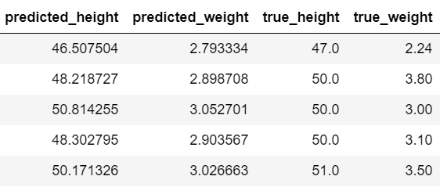
Analysis (1)
On Guinea data, Mobilenet_v1 tends to predict the mean height and weight.
Model: 5% for Height and 23% for Weight
Data has a Mean Relative Difference from the mean of 4.95% for Height and 22.3% for Weight
Mean height = 49.27cm
Mean weight = 2.94kg
Notes:
When trained on guinea data only,
mobilenet_v1 tends to predict the mean height and weight. we already saw
that the model have a Mean relative Error of 5% for height and 23% for weight,
but the data itself has a Mean Relative difference from the mean of almost 5% for Height and 22.3% for Weight.
And this can be confirmed from the predictions here ,
that are very close to the true mean values… So as a next step, we will focus on Mobilenet_v1 and try to achieve better performances on guinea data

Slide 21
Mobilenet_v1 (1)
Idea:
Train model on Cambodia dataset.
Then fine-tune it on newborns from Guinea.
➔ Mobilenet_v1 was trained:
C epochs on Cambodia with C in {0 , 1 , 2 , 3}
G finetuning epochs on Guinee with G in {10, 20, 30, 40, 50}
Cross validation
Guinee data is much less represented => higher number of epochs (G>>C).
Priority given to newborns from Guinee → Test on Guinee data only
Notes:
So to prevent it from predicting the mean values,
the idea is
to train the model on Cambodia dataset
then fine tune it on newborns from Guinee
So in this step, Mobilenet_v1 was trained
C full epochs on Cambodia,
then G finetuning epochs on Guinee,
with C and G being hyperparameters that we tune in by cross Validation.
And we set G much higher than C because Cambodia dataset is 10 times larger than Guinee dataset
Notice that Since our priority is to perform well on newborns from Guinee, we chose here to always test on Guinee data only.
Why this idea ? :
So, when using Mobilenet v1 on guinee data only, the model found that outputting the mean will lead to the best results. And since guinee images are only 700 images, and Cambodia dataset is 10 times larger, we thought that if we first train our model on Cambodia images, we can prevent it from predicting the mean and maybe it will gain more insights to perform the task

Slide 22
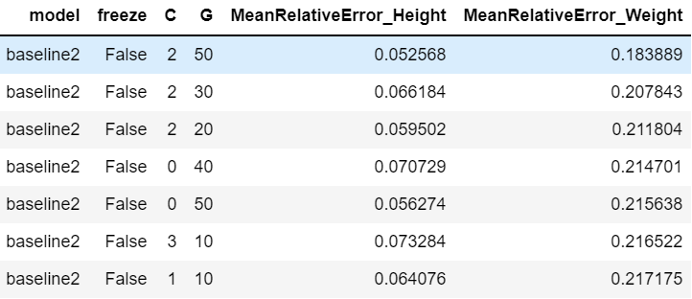
Mobilenet_v1 (2)
5.2% for Height
18.3% for Weight
Slight improvement (2%) for weight prediction
Notes:
Here are
the results we found.
And The best performance that we now have is when using Mobilenet_v1 with 2 epochs on Cambodia images and 50 epochs on Guinea.
This model achieves a mean relative error of 5.2% for Height
and 18.3% for weight. These results did not differ much from the results we had before,
but there is a slight improvement of 2% for weight predictions.

Slide 23
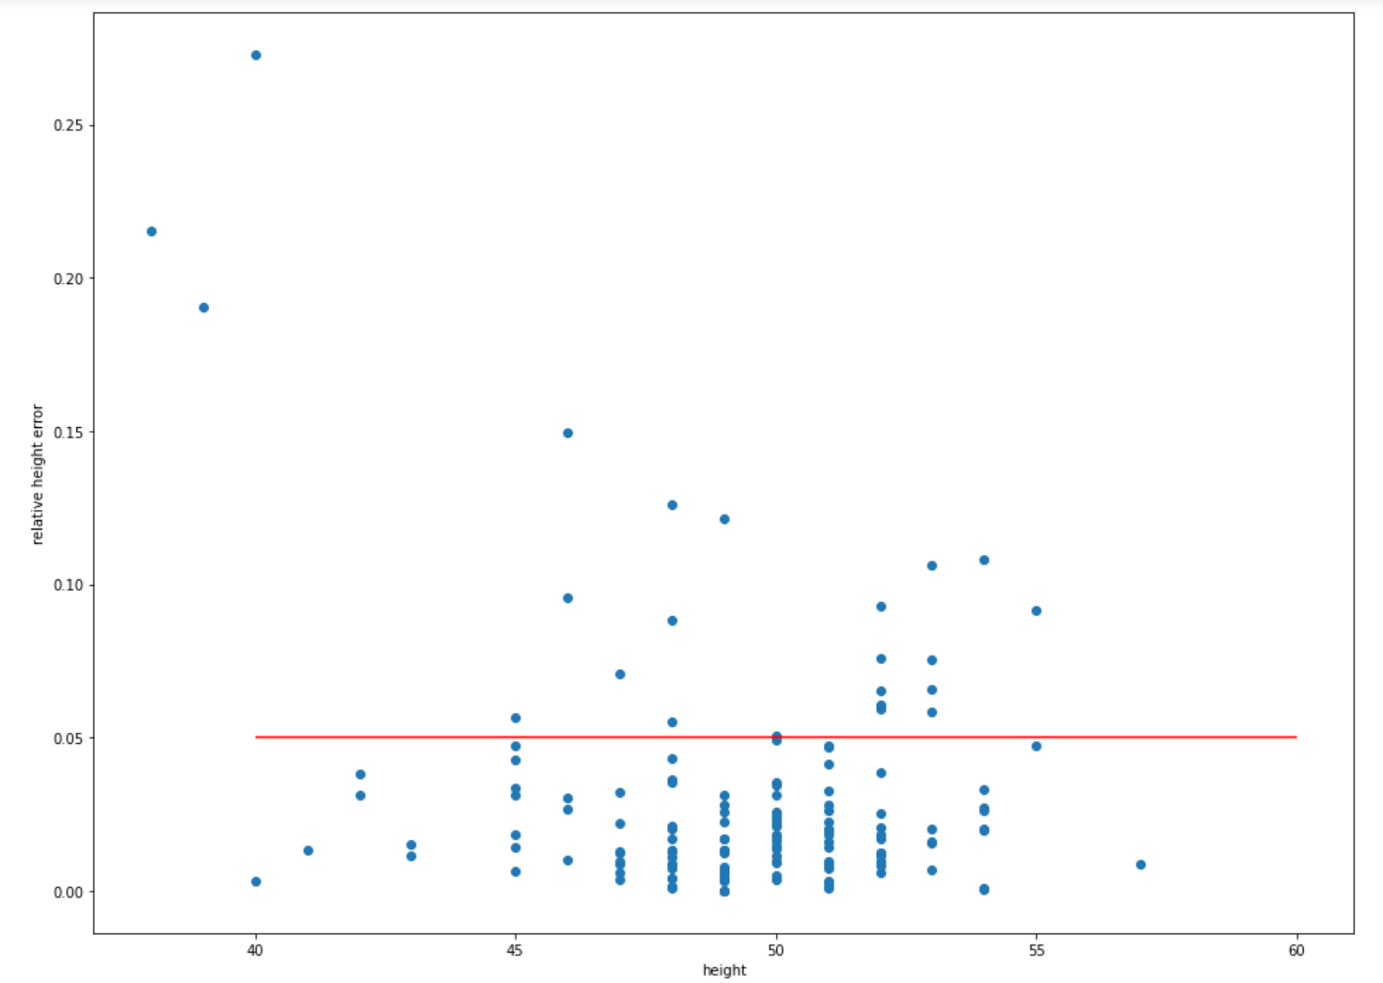
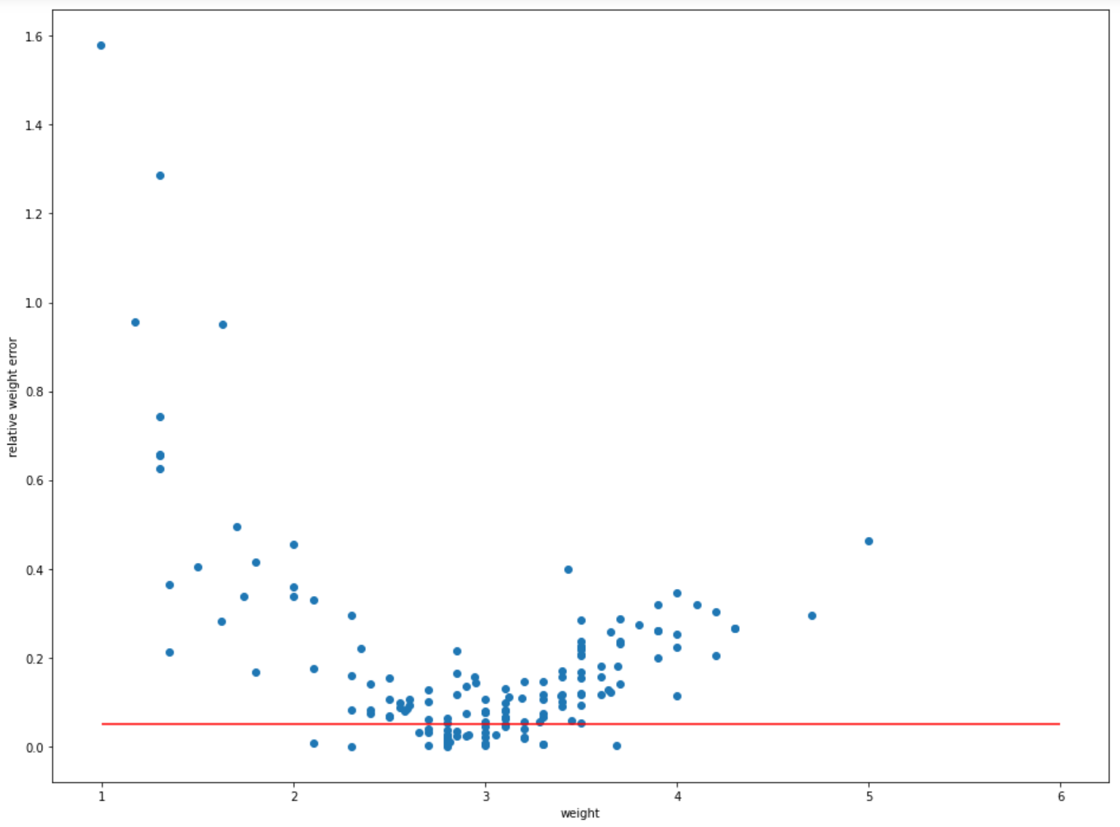
Analysis
Results are not satisfying especially for weight predictions
Model tends to predict Mean value for Height
5.2% mean height relative error
18.4% mean weight relative error
→ Idea: switch to Mobilenet_v2
Notes:
These results are
still far from satisfying especially for weight predictions. , And again,
we find that the model still have a tendency to predict the average height value. Now since mobilenet_v1 have the best performances until now,
we decided to switch to mobilenet_v2 as a next step.
Why switch to Mobilenet_v2 ?
Until now, we used Mobilenet_v1 with pretrained weights from OpenPose. And it had acceptable performances especially with height predictions. and Since Mobilenet_v2 have an overall better performances than its older version, we thought about trying it and see if we can improve our results before adding new features (Sex and age). This helped us notice that we didn’t gain much advantages when using Openpose weights for Mobilenet_v1 (since the results are better with Mobilenet_v2)

Slide 24
Mobilenet_v2 (1)
Model :
Freeze Mobilenet_v2 as Backbone.
Our initial regression model.
Train our model on two different dimensions:
(256x256)
(384x384).
Notes:
Now
our model is simply
a Mobilenet_v2 followed by
our initially defined regression model..
so far, we always trained our models on (256x256) images but now we will also train the model on (384x384) images and compare performances.
(why now (384*384)? because initially, openpose was trained on 256x256 sized images so we kept the same dimension)

Slide 25
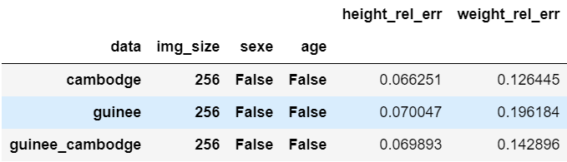
Mobilenet_v2 (2)
1. For (256x256):
Comparing to Mobilenet_v1 :
For Guinea data :
- Slight deterioration for Height (From 5.2% to 7%)
- Improvement for Weight (from 23% to 19.6%)
For Cambodia data:
- Slight improvement for Height (from 7.4% to 6.6%)
- Significant improvement for Weight (from 23.3% to 12.6%)
Notes:
So,
here are the results for 256 by 256 images
Comparing to Mobilenet_v1, we can see that
For Guinea data :
There is a slight deterioration in predicting Height (From 5.2% to 7%) ,
with a more significant improvement in predicting Weight (from 23% to 19.6%)
For Cambodia data, predicting Height
slightly improved from 7.4% to 6.6%, but there is
a notable improvement in predicting weight (from 23.3% to 12.6%)

Slide 26
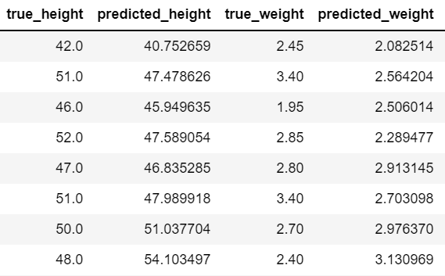
Analysis
Guinea images (Newborns)
Before, the model tends to predict the mean (49.27cm, 2.94kg)
The model predictions have now more variance
It seems that it gained more insight in predicting height
For height:
True Height increases
➔ predictions increase
For Weight:
Still have issues
Notes:
We can see
on the right, some predicted values for newborns from guinea
So , before, mobilenet_v1 tend to predict the mean values,
but now we can see that there is a increase in variance for our model predictions,
and it seems that now the model have gained more insights in predicting height :
See that When the true height increases ,
the prediction tend to also increase.
For Weights on the other hand, the model still have issues.

Slide 27
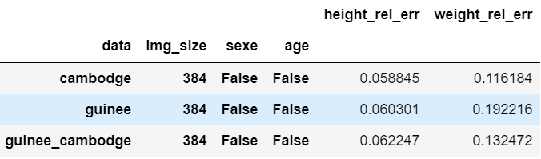
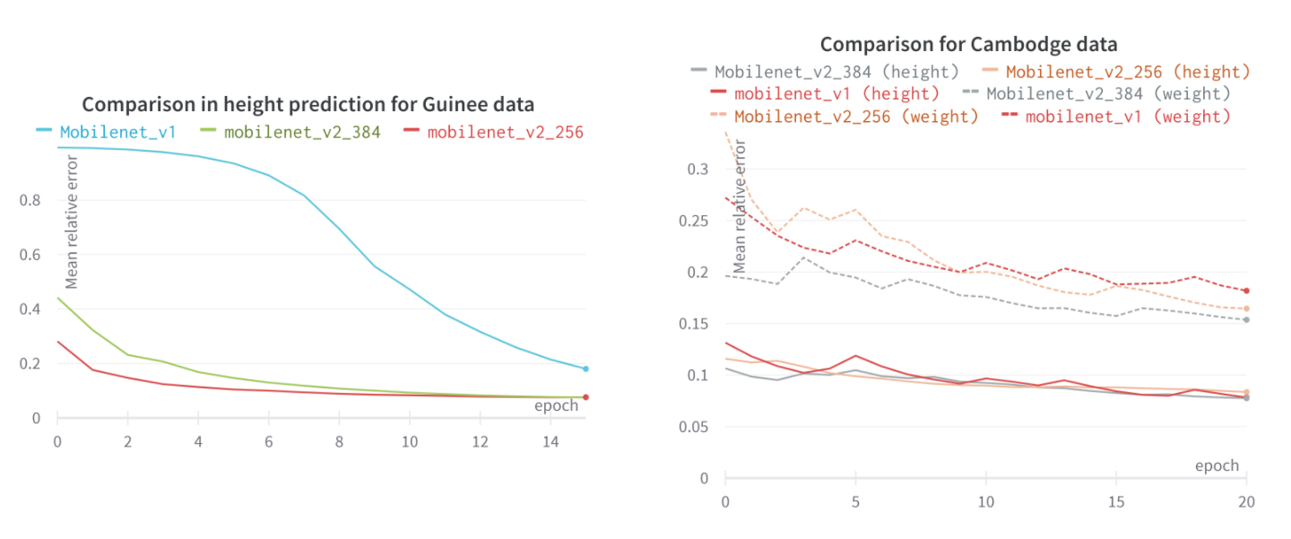
Mobilenet_v2 (3)
2. For (384x384):
weight predictions
→ 1% gain in Relative error for Height
➔ (384x384) leads to better results
Notes:
Now
for 384 by 384 images, the overall performances have improved and There is
A 1% gain in relative error for Guinee on height predictions.
We can see on the graph here, a comparison between Mobilenet_v1 in red, Mobilenet_v2 with dimensions 256 in orange and Mobilenet_v2 with dimensions 384 in gray.
And the improvement can clearly be seen for weight predictions represented by the dashed lines
so from now on, we will always use this dimension and try to improve our performances.

Slide 28
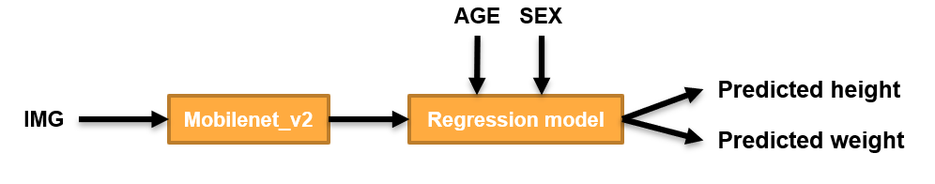
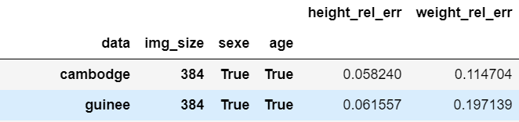
Integrate AGE and SEX attributes (1)
Informative features
First Approach
In Regression model:
AGE and SEX features were concatenated to the output of a Fully Connected layer with 32 output features and fed to a Fully connected layer with 34 input features and 2 output features.
No Improvement
Notes:
Now we will integrate AGE and SEX attributes
which are quite Informative features
So the first approach
is to simply add age and sex as additional input to our regression model
(so we will add two input features to our fully connected layer)
We can see the results here, and comparing to what we had before,
there is no improvement

Slide 29
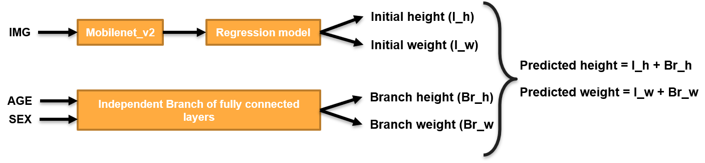
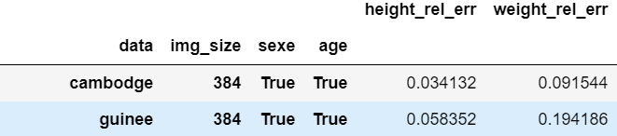
Integrate AGE and SEX attributes (2)
Second Approach
In Independent branch:
2% Improvement
for Cambodia
Notable overall Improvement
Notes:
Now,
The second approach
is to use an independent branch.
And as you can see it in the graph, we create a parallel independent branch of Fully connected layers that will predict a pair of values (𝑏𝑟anch ℎeight and 𝑏ranch 𝑤eight) . These values will then be added to the predicted values from the main network to constitute the final output.
Seeing the results, we can note
an overall improvement in performances,
Especially for Cambodia with a 2% improvement for both Height and Weight

Slide 30
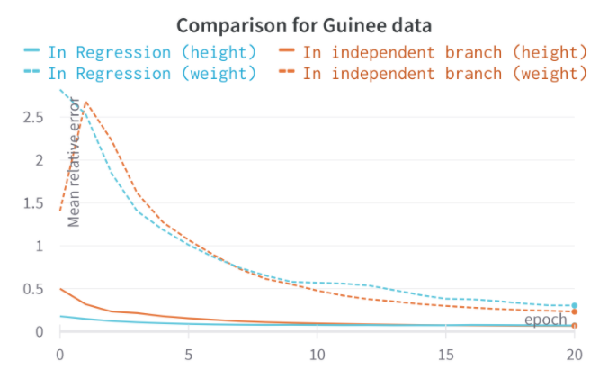
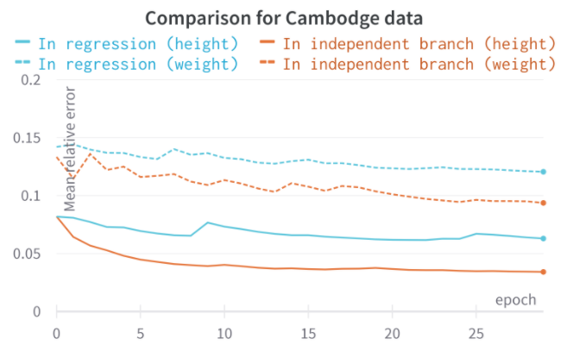
Comparison
Notes:
Here,
We can see a comparative graph between the two methods on Guinee data. it shows in dashed lines the weight mean relative error, with the blue color representing the first approach, and orange color representing the second approach
The improvement is better represented in the second graph for Cambodia data with a notable difference between the two techniques

Slide 31
How is the branch behaving ?
Idea:
Branch: Use SEX and AGE to predict mean (Height, Weight)
Main: Use Image to predict deviation from mean.
Different behavior depending on the dataset
Notes:
So, How is the branch behaving ?
The initial idea when implementing the second approach was that, using SEX and AGE attributes,
the branch will tend to predict the mean height and weight of children of similar sex and age.
While the main branch will then tend to use the image to predict the deviation from that branch mean value.. But seeing the results , It seems that the independent branch
behaves completely differently depending on the dataset:

Slide 32
How is the branch behaving ?
For Guinea: (Height)
Female Age=14d 40 | Male Age=14d 52 | Male Age=19d 52
True values
0.77 | 0.78 | 1.65
Branch predictions
41.11 | 52.94 | 52.06
Image predictions
41.88 | 53.74 | 53.72
Predicted values
Branch always increases image predictions ➔ Wrong Behavior
Notes:
So,
Analyzing the behavior for height for guinea images
Lets take these 3 samples
With their respective branch predictions,
image predictions,
and predicted values
These two samples share the same age but have opposite sex, but we find that they have almost the same Branch prediction.
The next two samples, share the same sex, with just 4 days difference in age. But we found that the branch predictions are far from each other.
The overall predictions of these samples are still accurate enough but we don’t get the wanted behavior because
the branch always increases image predictions even if they are already above the true value

Slide 33
How is the branch behaving ?
For Cambodia: (Height)
Female Age=33d 52 | Male Age=36d 54 | Male Age=748d 83
True values
38.37 | 39.67 | 59.53
Branch predictions
13.25 | 17.33 | 20.9
Image predictions
51.62 | 57.00 | 80.43
Predicted values
+ Branch estimates overall measure
+ Image gets additional information
➔ Good Behavior
Notes:
Now
for Cambodia images, again for height,
We take these 3 samples
With their respective branch predictions,
image predictions,
and predicted values
These two samples have almost the same age, but different sex, and the branch here almost predicts the same value.
These two samples have the same sex, but big difference in age (more than 2 years) and we see that the branch prediction increased significantly with age
The overall predictions are accurate enough,
And here the branch predictions seems to estimate an overall measure from age and sex,
then gets a complementary information from the image prediction to get near the true value.
This is the wanted behavior and leads to more accurate results.

Slide 34
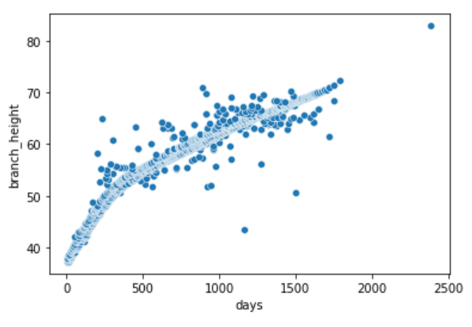
Analysis
Remember:
For Cambodia
Age correlated with (Height, Weight)
Sex not correlated with (Height, Weight)
Doesn’t have present information
➔ Model more accurate and gets good results
For Guinea
Age not correlated (Height, Weight)
Sex not correlated (Height, Weight)
Branch Predictions have no significance.
➔ Model performs better with Image only
Notes:
So,
remember that
for Cambodia, age is positively correlated with Height and weight, but sex is not.
So it doesn’t present additional information
Here, we find that branch predictions increase with age.
And The model is accurate and gets good results
For newborns from guinea, both sex and age are uncorrelated with height and weight,
So the branch have no significance,
And we find that the model performs better using only the image.

Slide 35
Summary
On Cambodia:
Height: 3.4%
Weight: 9.1%
On Guinea:
Height: 5.8%
Weight: 19.4%
For newborns :
Age and Sex attributes did not improve our model
Hypothesis:
Newborns gain less weight during their first months (Age for guinea between 4 and 40days)
Guinea dataset not sufficient (Cambodia dataset 10 times bigger)
Notes:
This is a summary of the results that we had.
On Cambodia 3.4% for height, and 9.1% for weight,
On Guinea 5.8% for height, and 19.4% for weight. So The only satisfying result is the prediction of Height for Cambodia images.
For newborns
Age and sex attributes did not improve performances
It may be that
newborns gain less weight during their first months, knowing that ages are between 4 and 40 days only for guinea data
And Cambodia data is 10 times bigger, so it seems we need more newborn images.

Slide 36
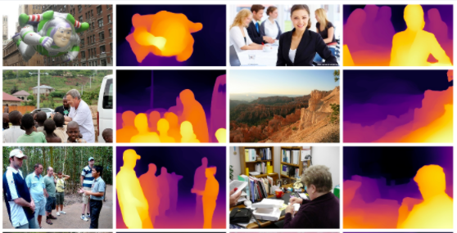
What to do next ?
Manually select newborns and lying children from Cambodia dataset and use them with Guinea data
Ensemble regression: combine several models in order to improve prediction accuracy.
Using depth as feature may help our model and improve predictions
→ Use a model to learn depth features from images:
Midas: Computes relative inverse depth from single image.
Notes:
We can
Manually select newborn and lying children images from Cambodia dataset then use them with Guinee data Mobilenet_v2.
We can also try Ensemble Regression and combine several models in order to improve the prediction accuracy.
Using depth as feature may help our model and improve predictions
so we can use a model to learn depth features of the images
For example, MiDaS model. Which output is shown in the image

Slide 37
Thank You
Notes:
Thanks everyone for your attention, and I hope I didn’t bore you .
Now I’ll be glad to answer any question you may have.

Slide 38
BACK UP SLIDES

Slide 39
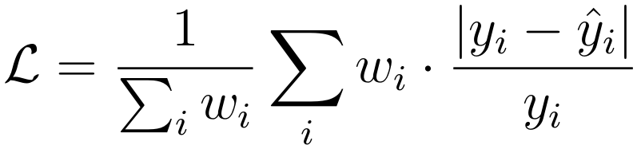
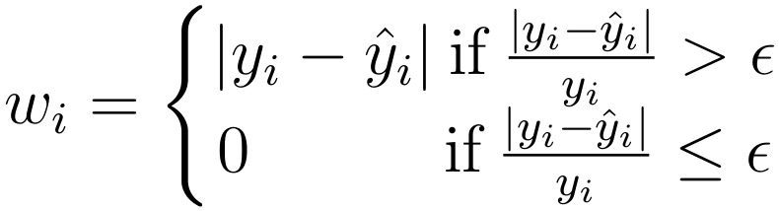
Previous work (1)
Custom Loss:
Only penalizes predictions of height and weight that vary more than 5% from the true values.
This custom loss function will be used throughout the project and is defined as :
Notes:
to only penalize predictions that vary more than 5% from the true values.
How does the loss work ?
So for each sample, we check if the relative distance between the predicted value and the true value is more than 5%
If it is more, we set W ,which is the penalizing term, to be the absolute value of the difference between the two (predicted value and true value)
If it is less than 5%, we set W to zero.
Then the loss, will be a weighted average (weighted by the penalizing terms W_i) of the relative distance between predicted value and true value

Slide 40
Previous work (2)
Linear Regression :
Advantages:
Easily interpretable
Accommodate custom loss
Disadvantages:
Has the tendency to predict the average height/weight
Not robust against occlusion.
Requires a reference object (tennis ball).
2. KNN:
Advantages:
Estimation is weighted average of the closest K samples.
Model is more robust to outliers.
Disadvantages:
Needs to store a database of the existing samples in the application.
Less interpretable than linear regression.
Notes:
So at first,
Linear regression was tested.
It is easily interpretable and can accommodate custom loss functions.
But it had a tendency to predict the average height/weight, is not robust against occlusion , and requires a reference object which is a Tennis Ball
KNN was also tested,
With the estimation being w weighted average of the closest K samples, so the model is more robust to outliers
But it needs to store a database of all the samples in the application and is less interpretable than linear regression

Slide 41
Previous work (2)
1. Linear Regression :
Features are the estimated length and width of the limbs and the body mask perimeter and area.
Tennis ball is used to scale the features.
Easily interpretable.
Can easily accommodate custom loss functions to achieve specific objective of predictions of height and weight
Disadvantages:
- Makes relatively strong assumptions on the underlying data distribution
- Has the tendency to predict the average height/weight
- Not robust against occlusion.
- Requires a reference object (tennis ball).
Notes:
So at first, Linear regression was tested. It is easily interpretable and can accommodate custom loss functions.
But it had a tendency to predict the average height/weight, is not robust against occlusion , and requires a reference object which is a Tennis Ball

Slide 42
Previous work (3)
2. KNN:
Estimation is based on a weighted average of the closest K samples in the database.
Similarity between samples relies on the same features as for linear regression.
Model is intrinsically more robust to outliers as they are by definition far from the other samples.
Mitigates the problem of having different models based on region or age of the child.
Disadvantages:
- Needs to store a database of the existing samples in the application.
- Less interpretable than linear regression.
Notes:
K nearest neighbors was also tested with estimations being a weighted average of the closest K samples, this model was more robust to outliers but is less interpretable than linear regression and needs to store a database of the all-existing samples in the application

Slide 43
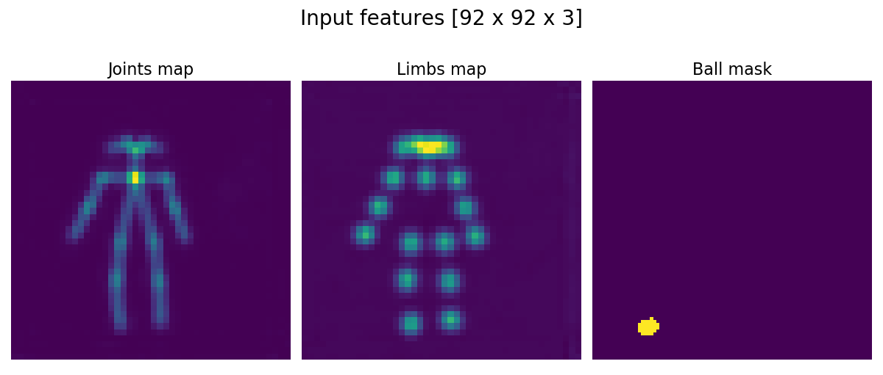
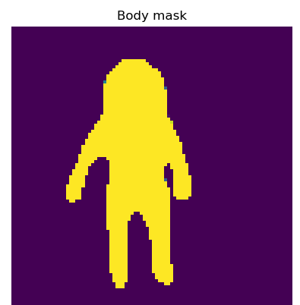
Previous work (3)
3. Second model, based on OpenPose features:
Contains same information as the previous models, with additional information about relative position of each limbs.
The ball mask provides information w.r.t. the scaling and the compression in each direction (H, W).
Relevant features are extracted with a convolutional architecture.
Prediction of height and weight with a single model.
Notes:
Another approach was to use a second model based on OpenPose features which are the joints and limbs maps
All These methods were more accurate in predicting height than weight, but the results were not satisfying , especially for lying kids which are mainly newborns

Slide 44
Data (2)
Guinea:
With 396 Females and 370 Males, we can assume that the data is Balanced in SEX attribute.
Heights are between 38cm and 57cm, with mean height = 49.27cm
Weights are between 0.99kg and 5.5kg, with mean weight = 2.94kg
Ages are between 1days and 40days, with mean age = 9.34 days
Notes:
For Guinee images, the data is balanced in SEX, and we calculated the border and mean values of our attributes Height Weight and Age for a later use
As we could imagine, we can see from the heatmap that Height and Weight are highly correlated.
We can also see that SEX has a weak positive correlation with height and weight, and Age is almost uncorrelated with height and has a weak negative correlation with weight, which is a bit surprising since a new born should normally gain between 0.25 and 0.5kg in the first two weeks.

Slide 45
Data (3)
2. Cambodia
With 3592 Females and 3349 Males, we can assume that the data is Balanced in SEX attribute.
Heights are between 44.75cm and 110.6cm, with mean height = 82.36cm
Weights are between 2.5kg and 22.8kg, with mean weight = 10.36kg
Ages are between 6days and almost 7years, with mean age = 2.34 years
Notes:
The data is also balanced in SEX For Cambodia images
Here, on the heatmap, we can see that height and weight are highly correlated (more than what we saw with guinea data). As in Guinea, SEX attribute is almost uncorrelated with height and weight. But Notice here that AGE attribute is highly correlated with both height and weight. This is expected since kids in this dataset have a wide range of ages.

Slide 46

Pretrained lightweight OpenPose model (2)
Bad results
PAFs are not sufficient
Model may be way too complex for Guinee images
Notes:
As expected, the model did not perform well and we are far from our 5% goal. The regression only uses PAFs which are the connected joints to make its prediction, and this is not enough because we lose a lot of information from the initial image
We can see that the mean relative error for both Height and weight for Guinee (with 46 and 47 %) was way higher than for Cambodia (with 20 and 28%) , this big difference may be explained by the fact that the Guinee data consisting of only 7 hundred images is not enough for a model of this complexity.
(here we did not use any data transformation)

Slide 47
Pretrained lightweight OpenPose model (3)
Halfway through Initial Stage
We created 4 models with same regression part but with different inference models, each one will stop in one of those 4 steps:
Baseline_1 : Inference model stops halfway through Mobilenet_v1.
Baseline_2 : Inference model stops at the end of Mobilenet_v1.
Baseline_3 : Inference model stops after CPM.
Baseline_4 : Inference model stops after halfway through Initial Stage.
Notes:
So as a next step, we visualized the output or feature maps of each phase in the OpenPose lightweight network and we created 4 models with same regression part but with different inference models, each one will stop in one of those 4 steps:
In Baseline_1 the Inference model stops halfway through Mobilenet_v1.
In Baseline_2 : Inference model is basically Mobilenet_v1 .
In Baseline_3 : Inference model stops after Convolutional Pose Machines.
And in Baseline_4 : Inference model stops halfway through Initial Stage, so just before generating PAFs and heatmaps
(Basically, in the initial stage, there is a block of convolutions that is applied to the input, and the result of that block is then fed to two different blocks of convolutions, one will lead to the PAFs and the other to the Heatmaps. In baseline 4 we stopped at the output of the first block, so before separating PAFs and Heatmaps.)
Whole model is way too complex for the data we have. We choose to visualize feature maps and manually choose when to stop the inference model. So here we chose 4 different places to stop at, halfway through Mobilenet_v1, then at end of Mobilenet_v1, then after CPM and finally just before producing joints and limbs. (before the separation) by training those 4 models we can know where to stop the inference model.

Slide 48
Results
Notes:
By training those 4 baseline models on our two datasets, , in both freeze mode and without freeze mode, we saw that there is not much difference between freezing the inference model or not, so here we just relay the results in freeze mode.
And we can see from the table, that overall, Baseline 2 which is basically Mobilenet_v1, is the most performant model, with mean relative error for height of 5.2% for Guinee images and 7.4% for Cambodia images.
The mean relative error for weight Is 23% for both datasets and is still high but improved significantly compared to what we had before.
Training is done for 30 epochs, with batch size of 128, using Adam optimizer and a learning rate of 0.05, with a train_test split of (80%,20%) for 4 different seeds

Slide 49
Mobilenet_v1 (2)
Notes:
Again here, we trained our model in both modes freeze and non-freeze, but without freezing we found the best performances so we relay it in the table below.
The best performances that we now have is when using Mobilenet_v1 with 2 epochs on Cambodia images and 50 epochs on Guinea. This model achieves a mean height relative error and mean weight relative error of 5.2% and 18.3% when backbone is freeze.
These results did not differ much from the results we had before, but there is a slight improvement of 2% for weight predictions.

Slide 50
Mobilenet_v2 (3)
2. For (384x384):
Notes:
Now for 384 by 384 images,
and as you can see on the table, the overall performances have improved and There is a 1% gain in relative error for Guinee on height predictions, so from now on, we will always use this dimension for our images and try to improve it.
This improvement can also be seen in Cambodia data especially for weight predictions.

Slide 51
AGE
SEX
Predicted height
IMG
Mobilenet_v2
Regression model
Predicted weight
Initial height (I_h)
IMG
Mobilenet_v2
Regression model
Initial weight (I_w)
Predicted height = I_h + Br_h
Branch height (Br_h)
Predicted weight = I_w + Br_w
AGE
Independent Branch of fully connected layers
SEX
Branch weight (Br_w

Slide 52
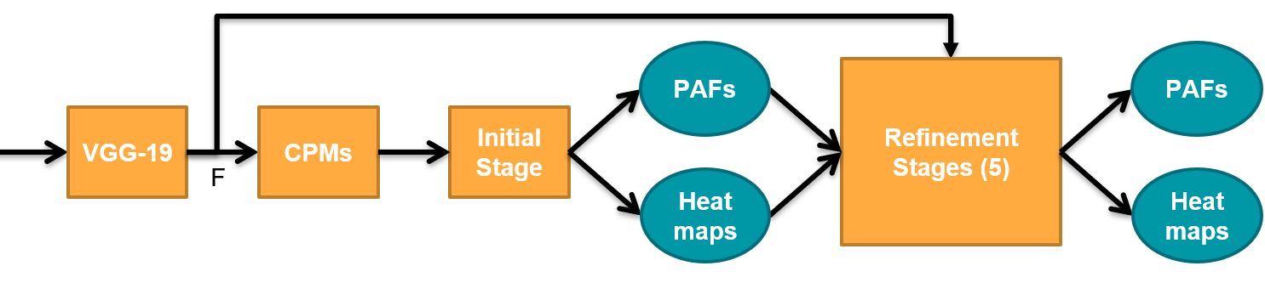
PAFs
PAFs
Refinement Stages (5)
VGG-19
CPMs
Initial Stage
F
Heatmaps
Heatmaps

